Slide 1


Protein co-folding predictors for protein-protein interactions
Jasper Zuallaert

Slide 2
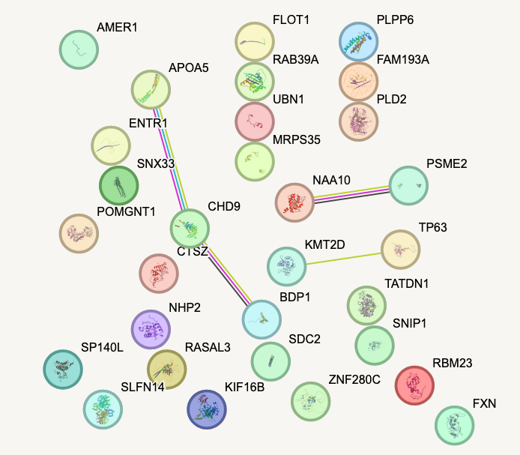
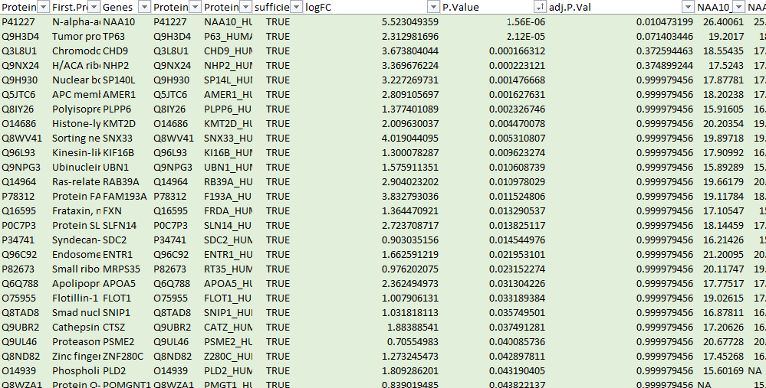
Objectives for this class
Work together to cover a set of protein-protein interactions
Evaluate a set of interactors based on previous sessions
Include non-interactors as negative control to validate methodology
Distribute workload!
One individual report per student
1.5 to 2 pages (incl. figures/tables)
Brief description of the methodology
Small overview + interpretation of results (for the subset that the student worked on)

Slide 3
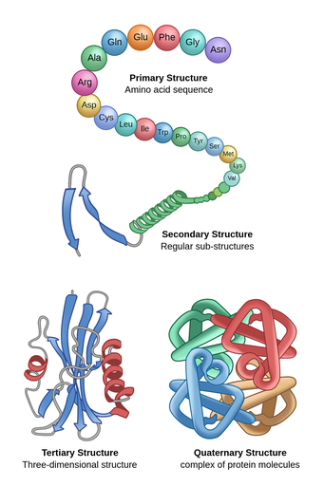
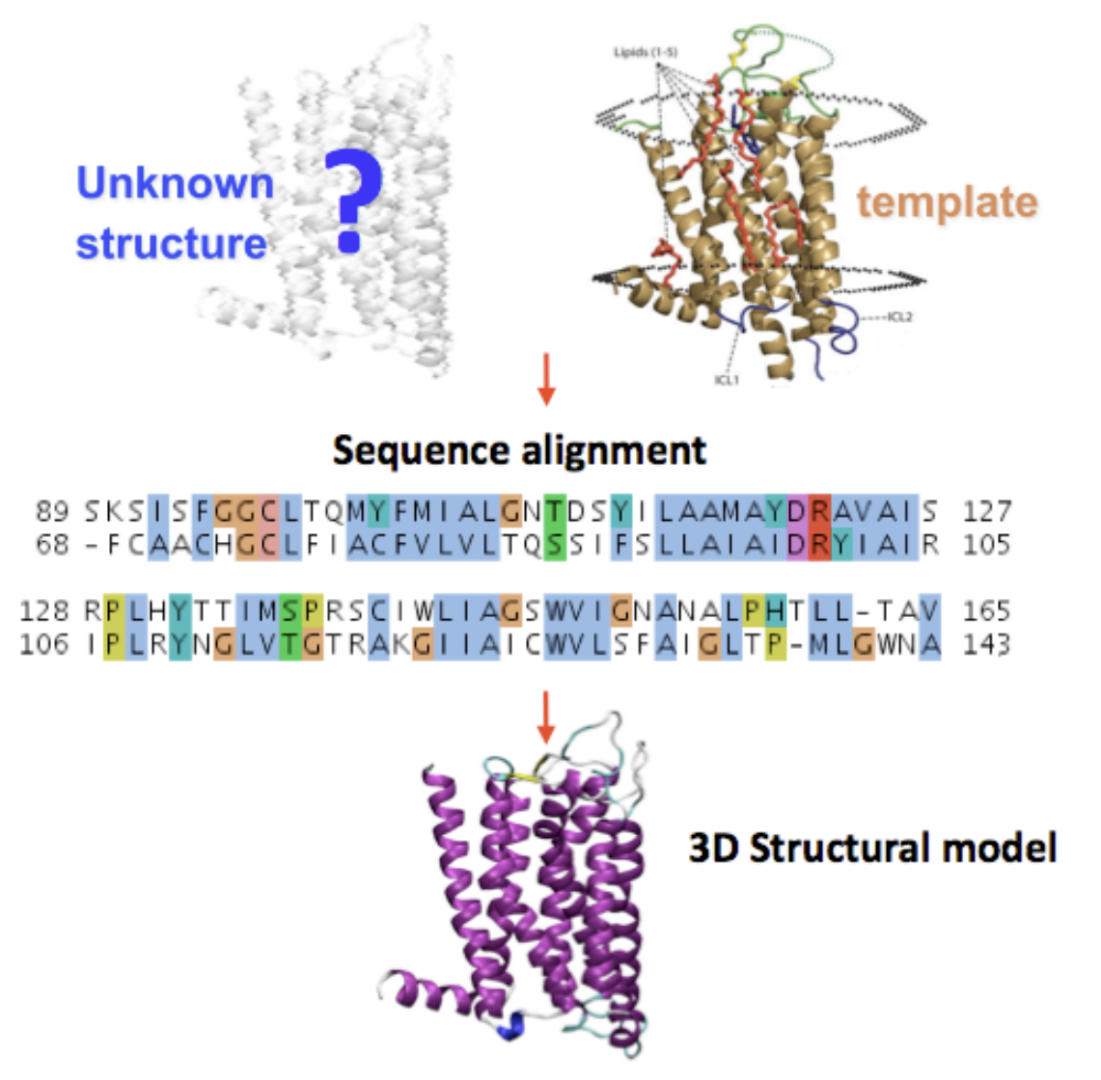

Slide 4
1. Protein co-folding predictors: a brief history

Slide 5

There lived a stagnating CASP competition…

Slide 6
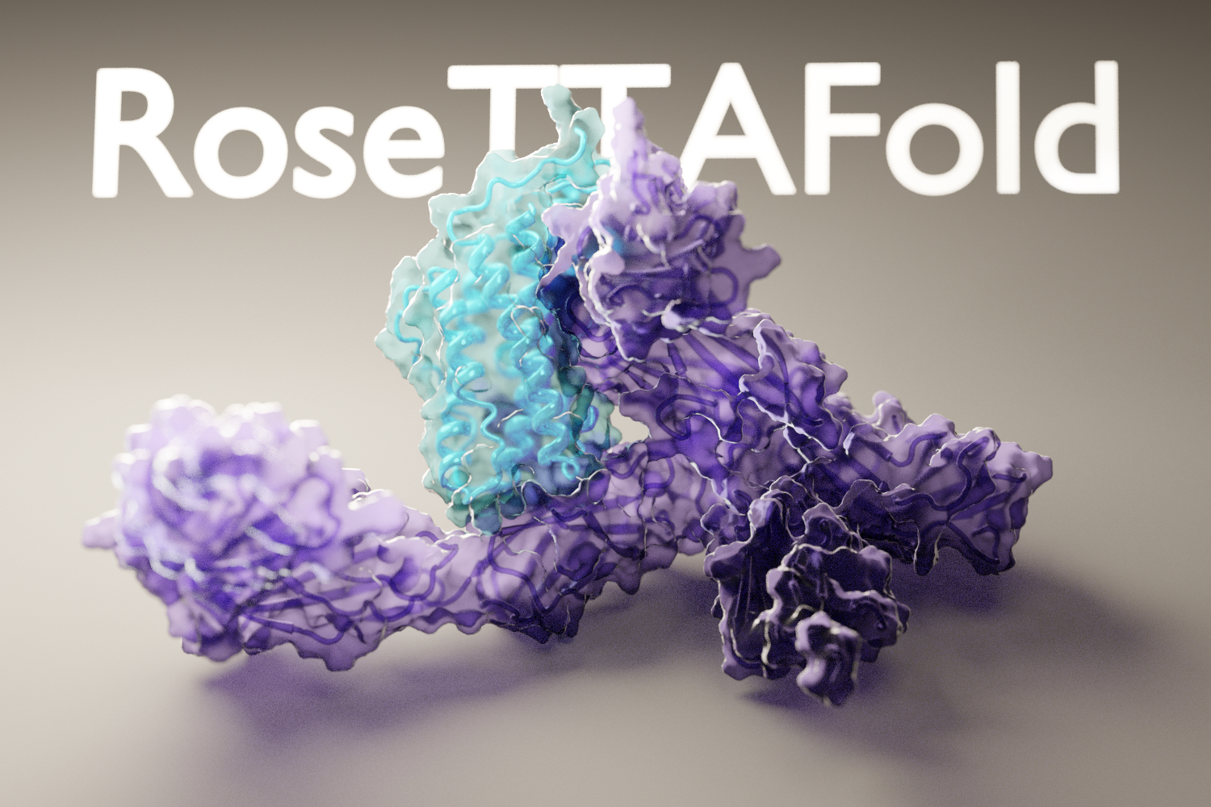
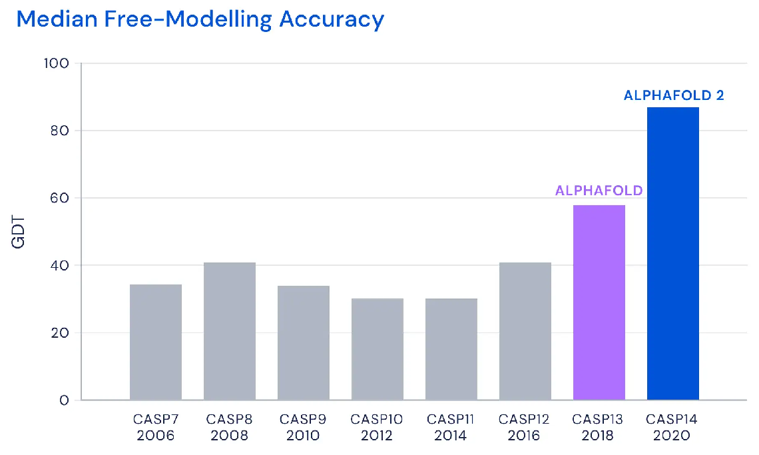
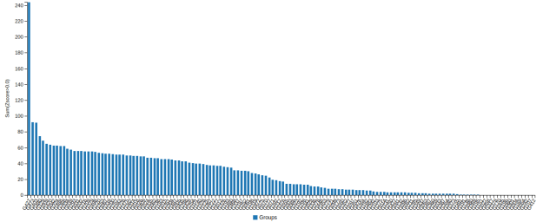
Critical Assessment of Structure Prediction (CASP14, 2020)
AlphaFold2
+ ideas from
Baker lab
CASP14, performance over all targets

Slide 7
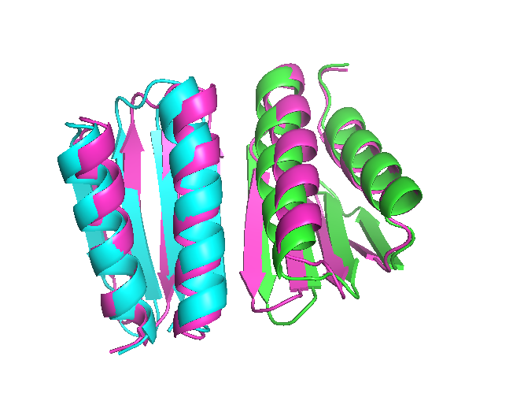
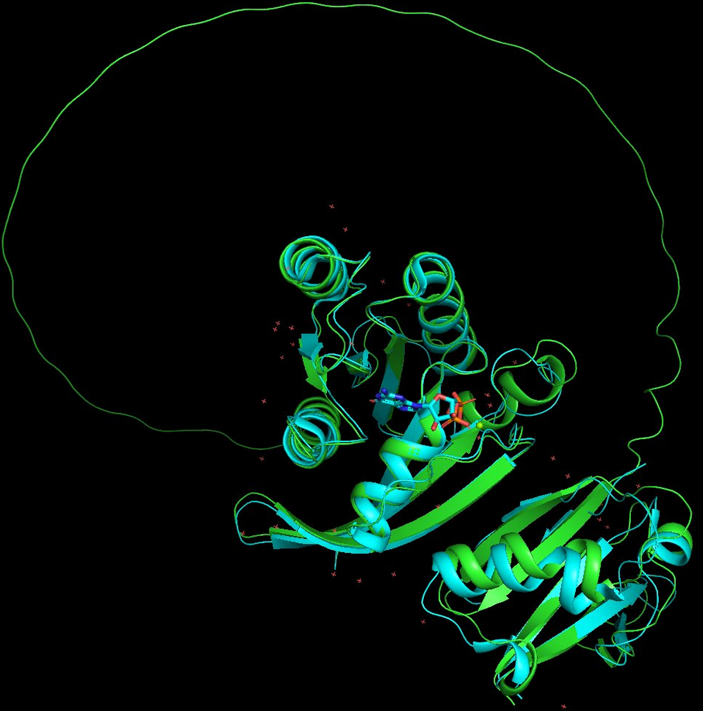

Protein complex prediction with AlphaFold-multimer
2. Separate chains programmatically
3. AlphaFold-Multimer
1. Single chain with pseudolinker

Slide 8
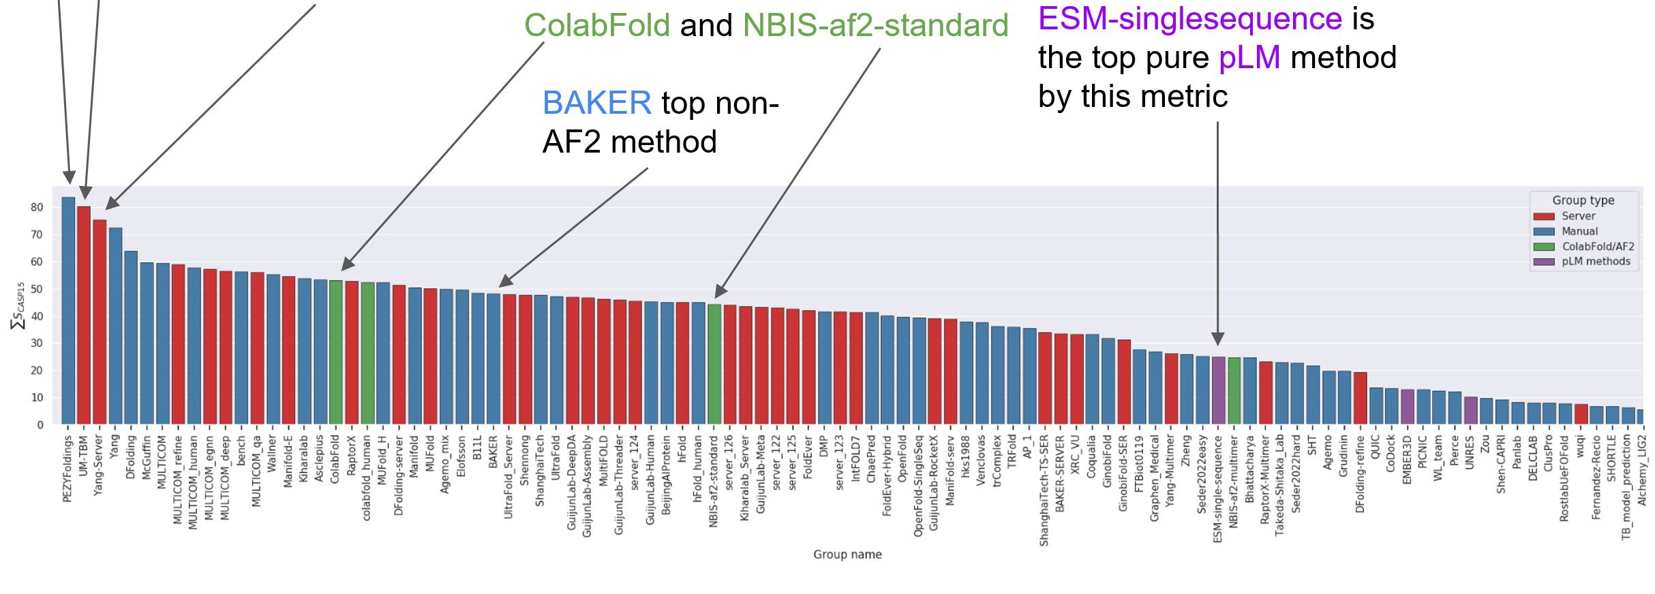
Critical Assessment of Structure Prediction (CASP15, 2022)
absence of evidence
!=
evidence of absence
Complex prediction competition:
→ Afsample = 6000 predictions per target (+ select best)
<-> default AlphaFold: 5 (v1) / 25 (v2) per target
(image source: Twitter @AlbertVilella)

Slide 9
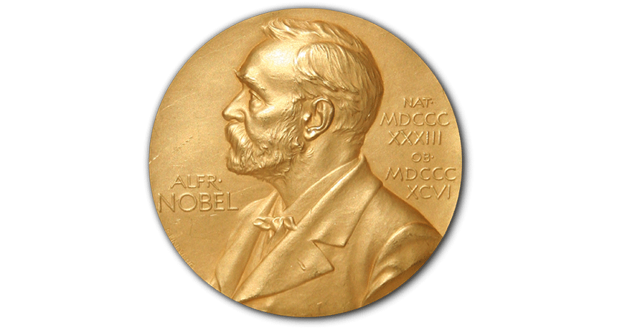
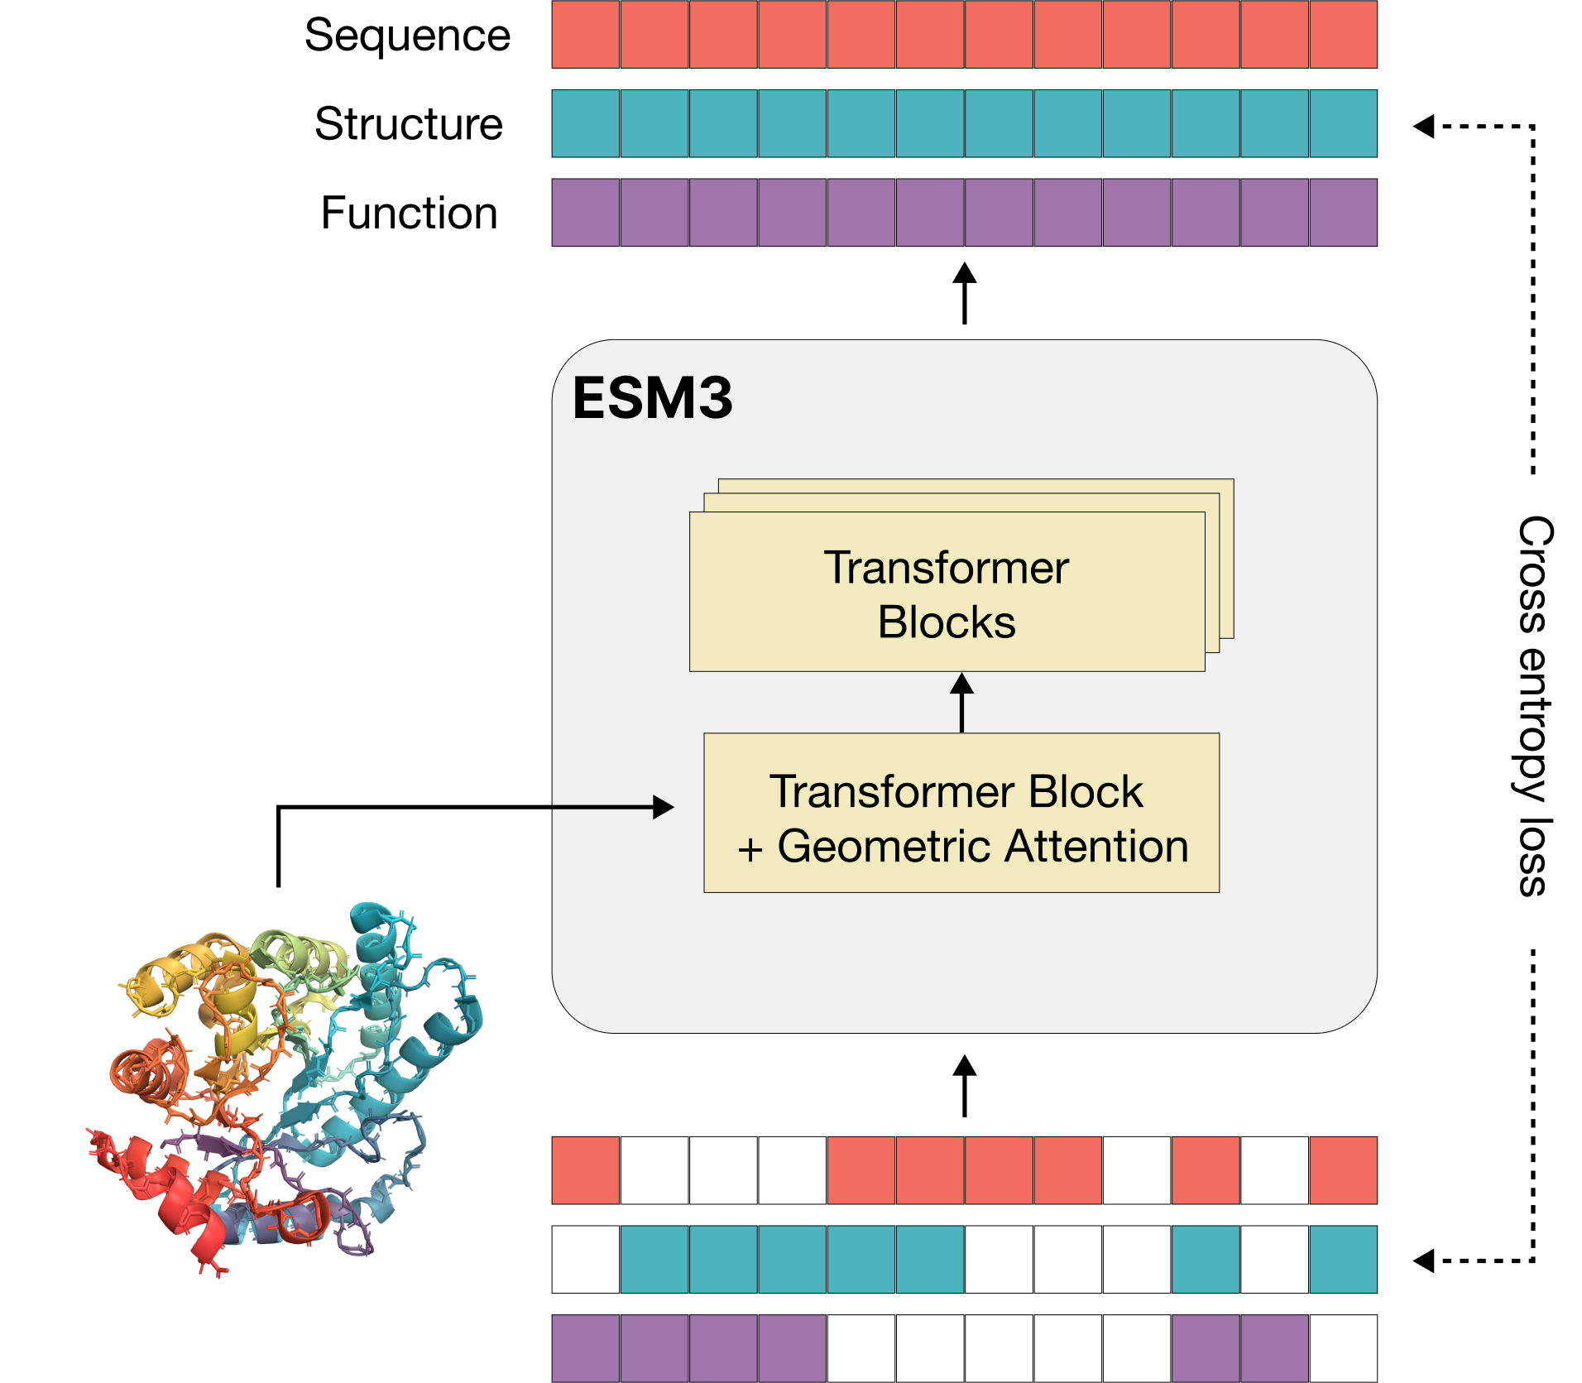
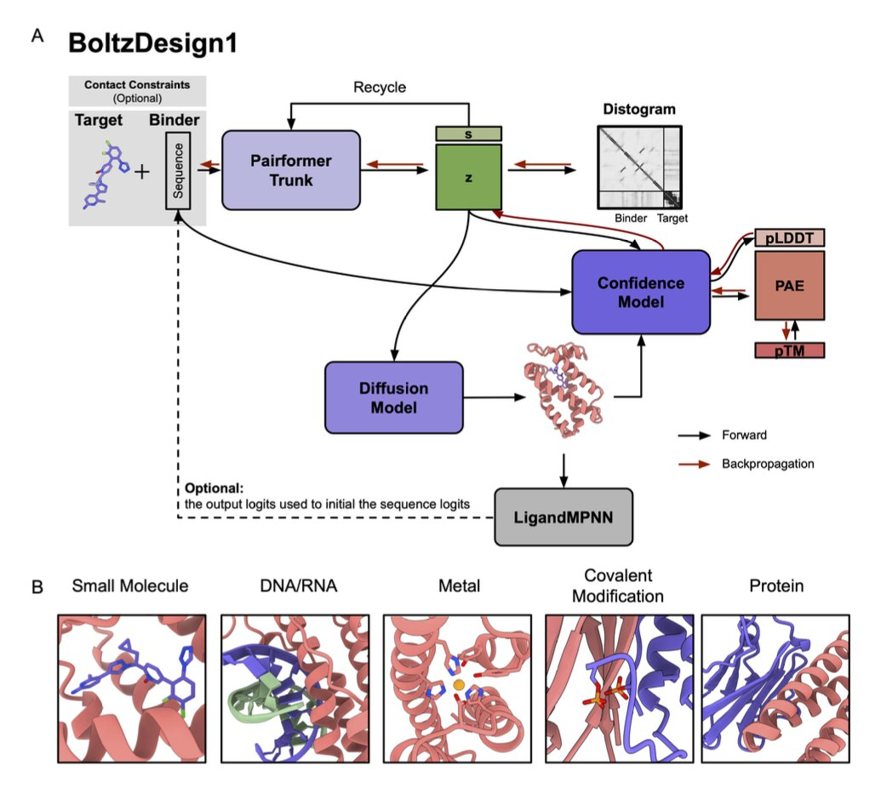
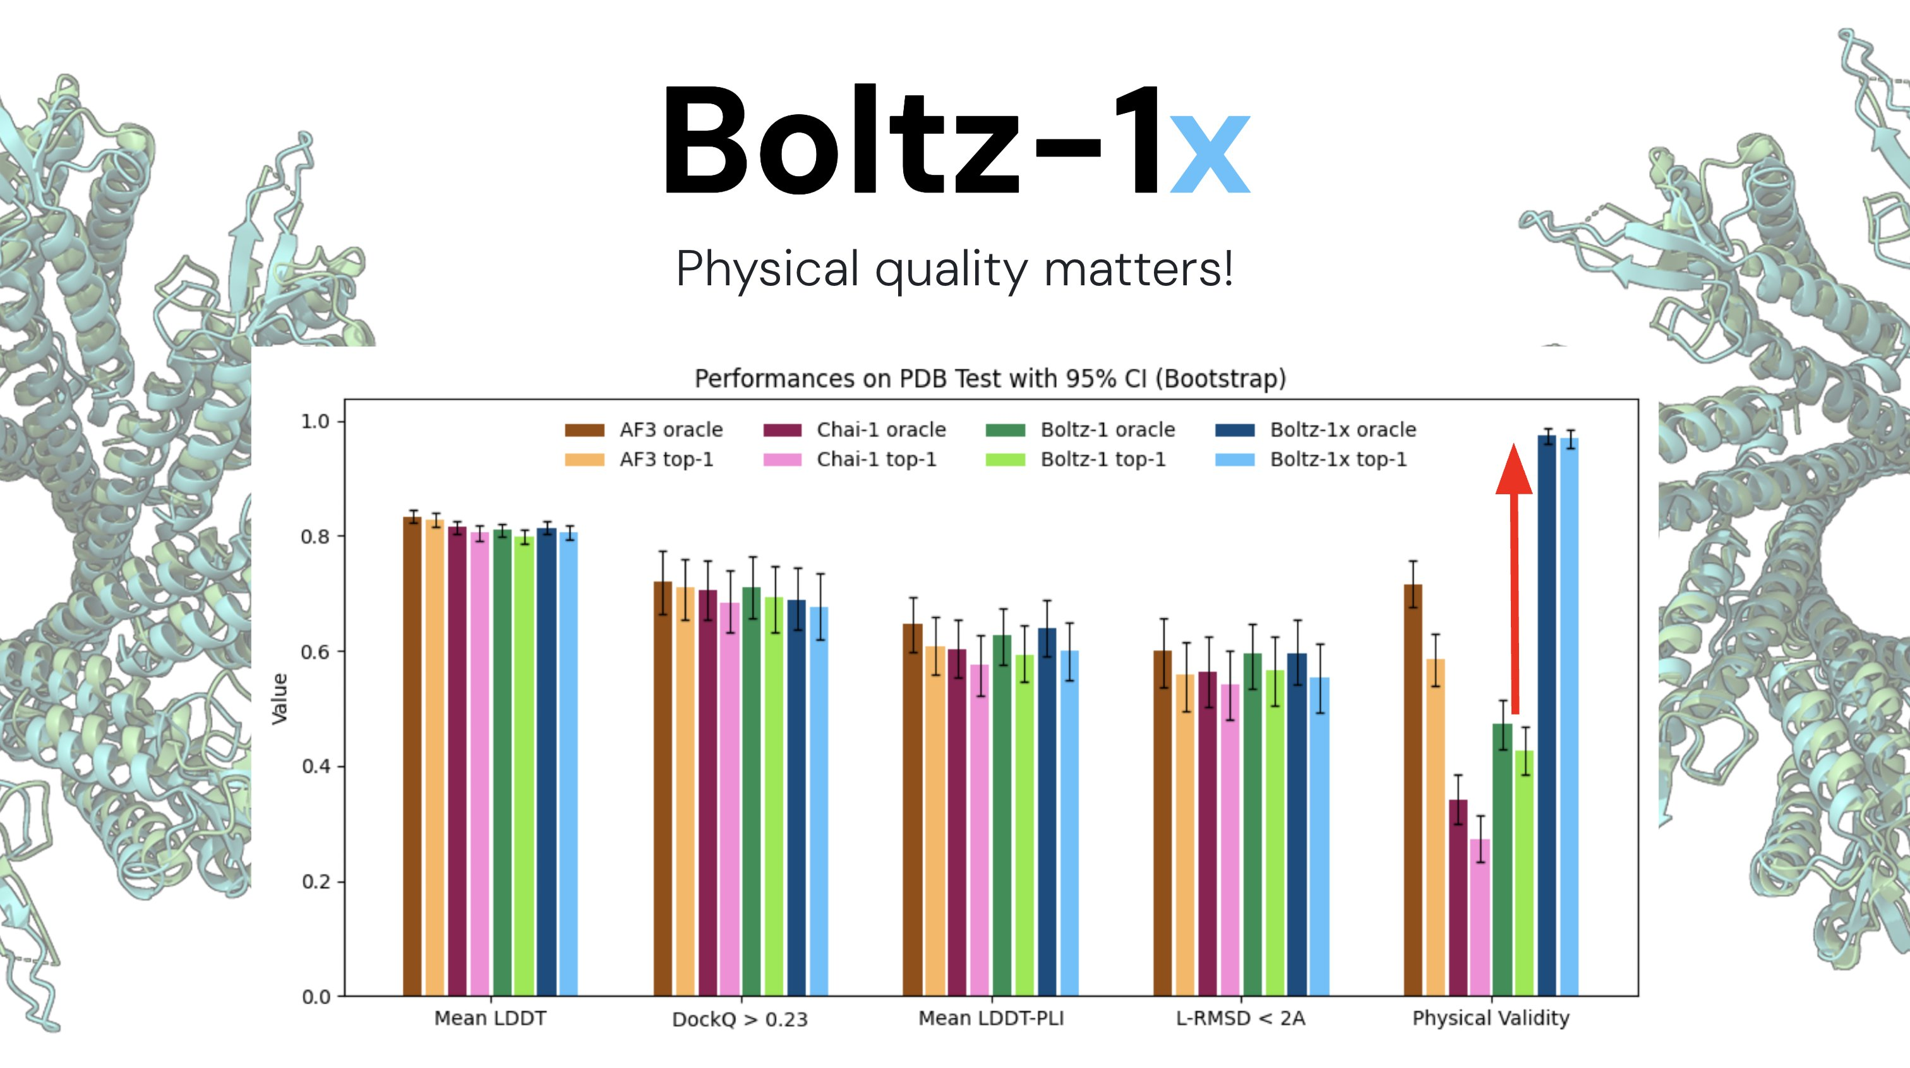
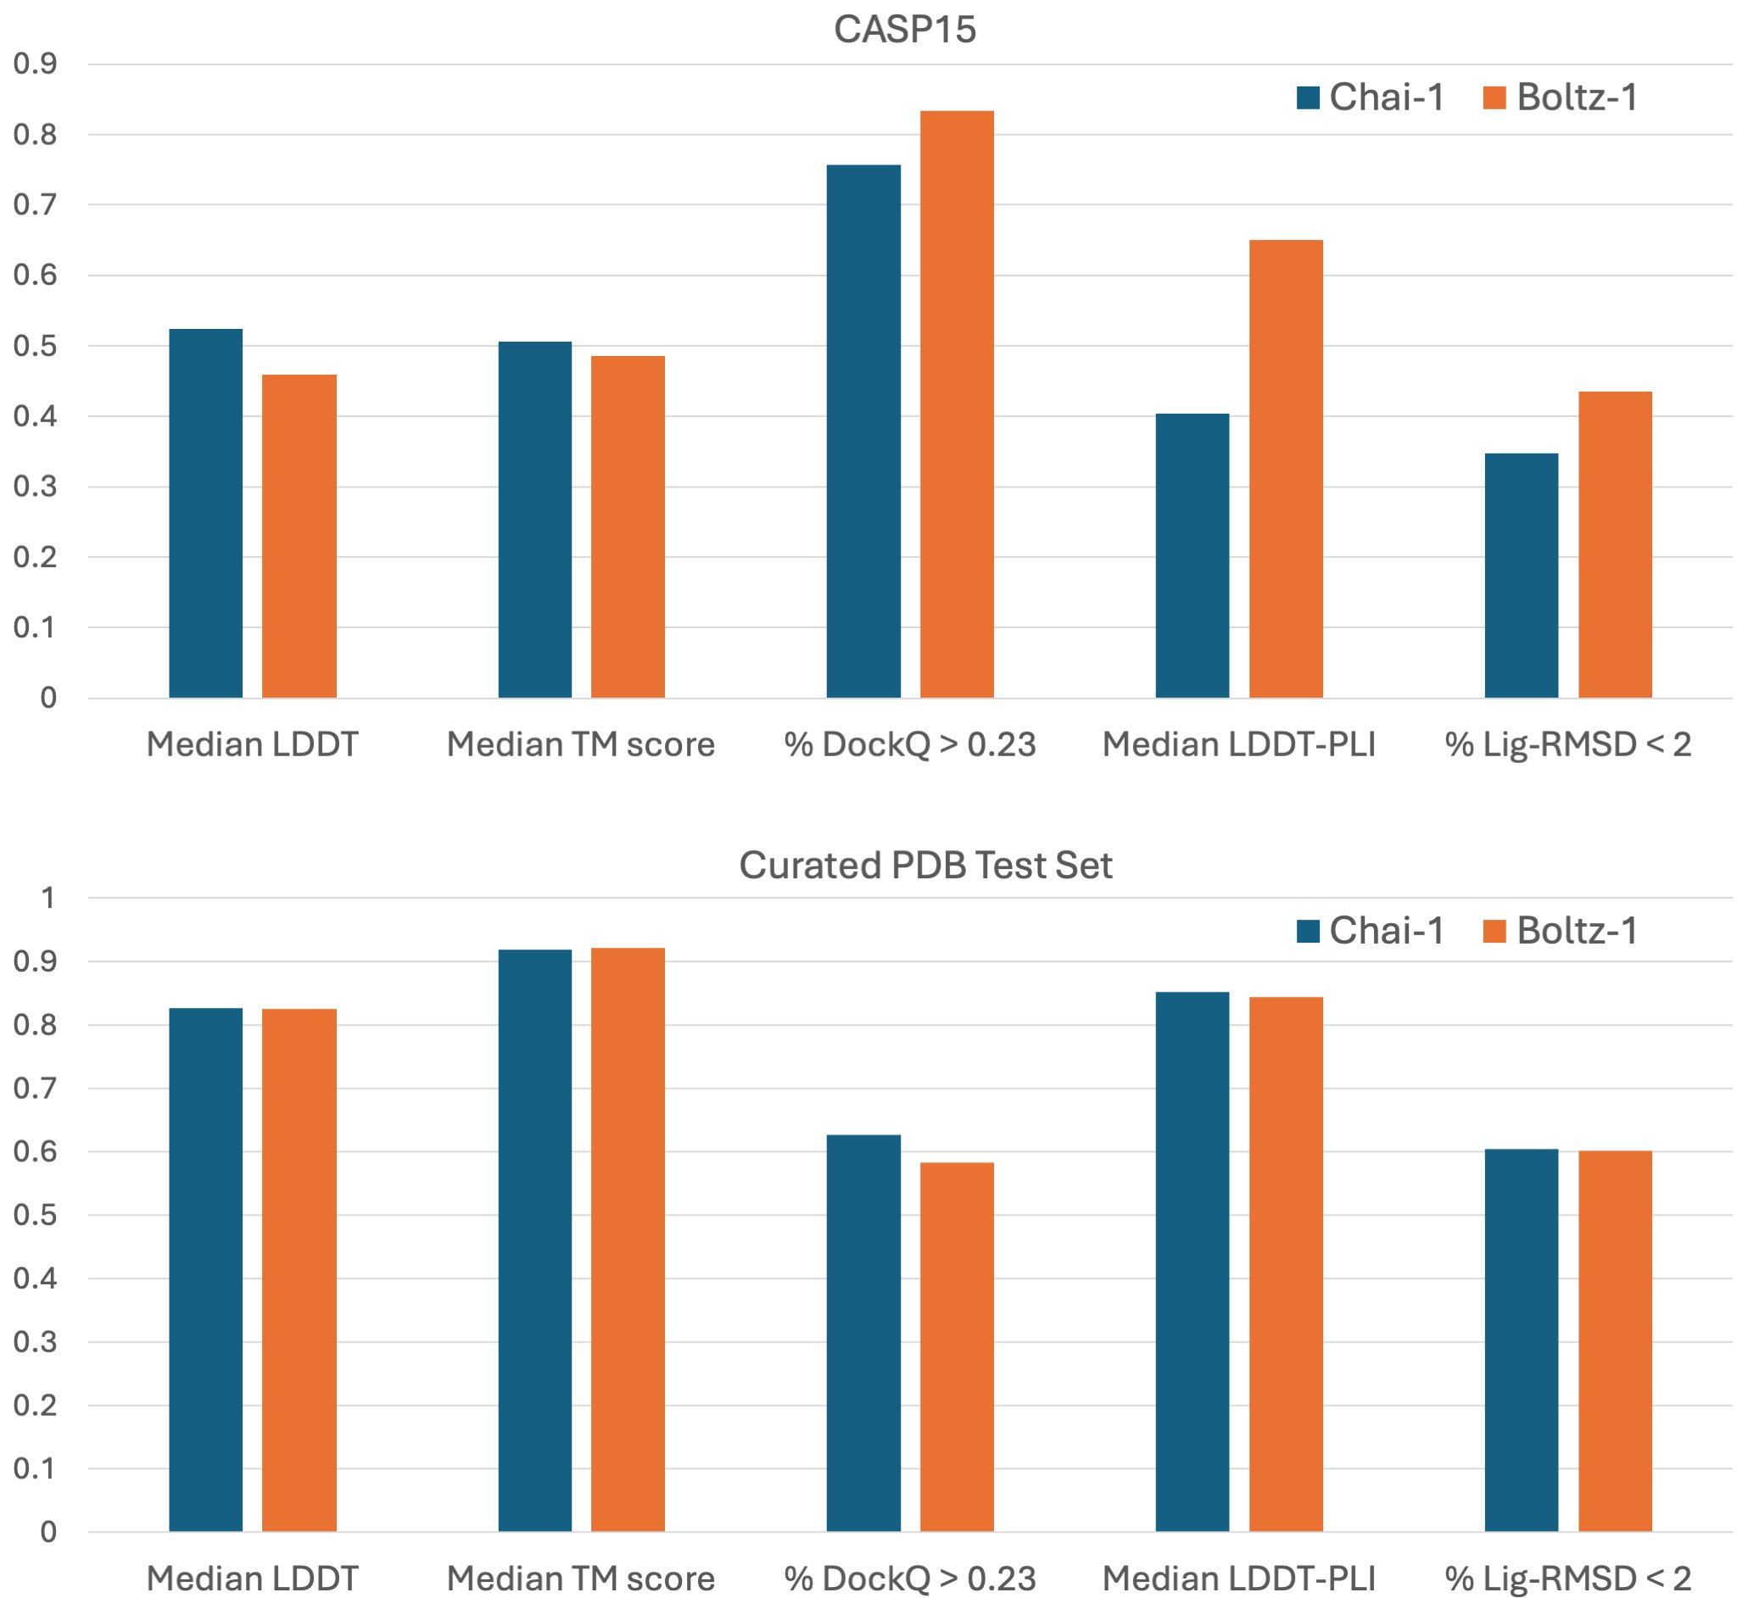
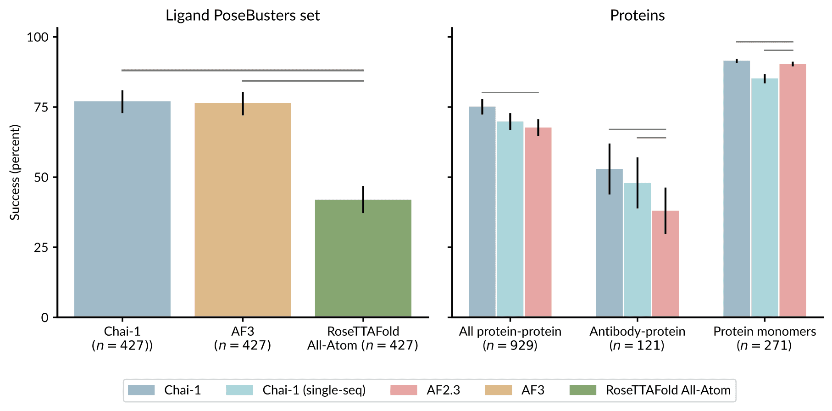
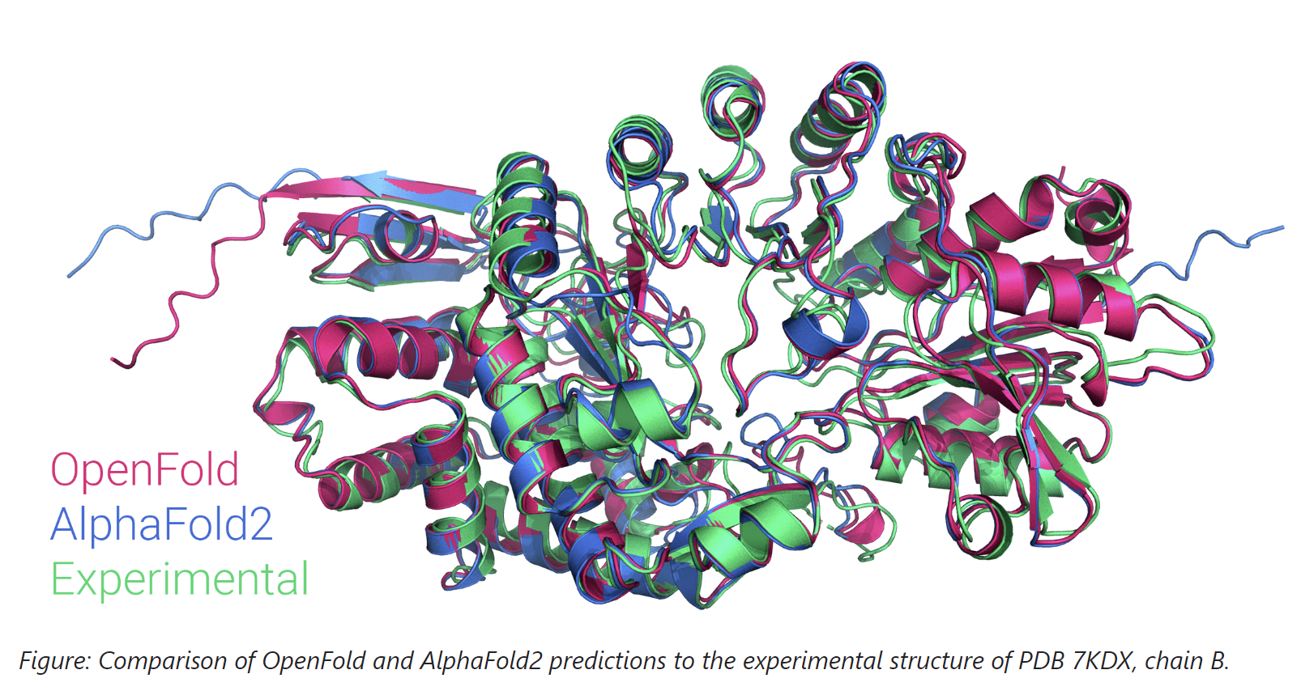
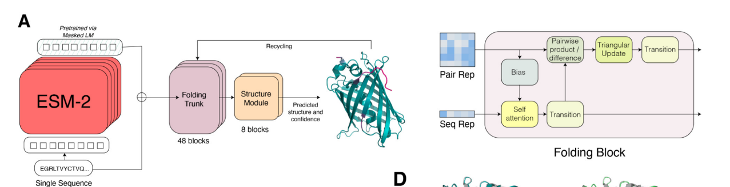

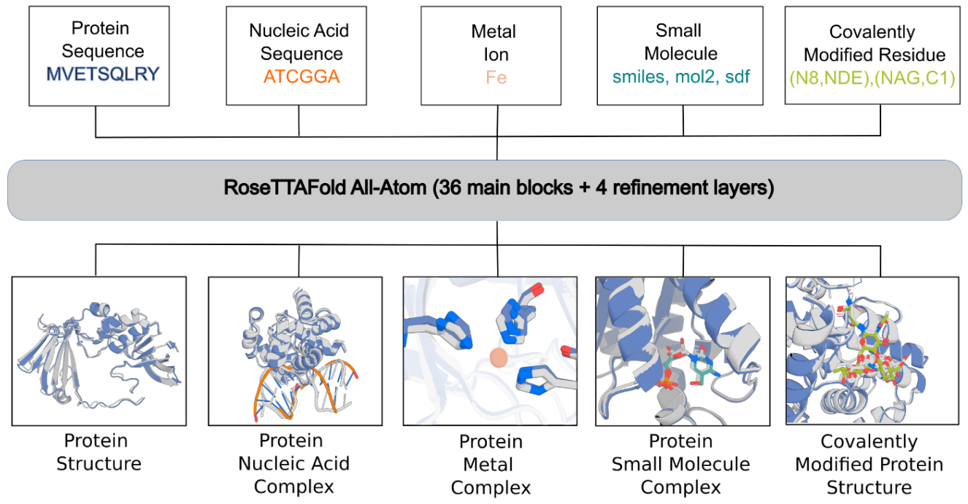
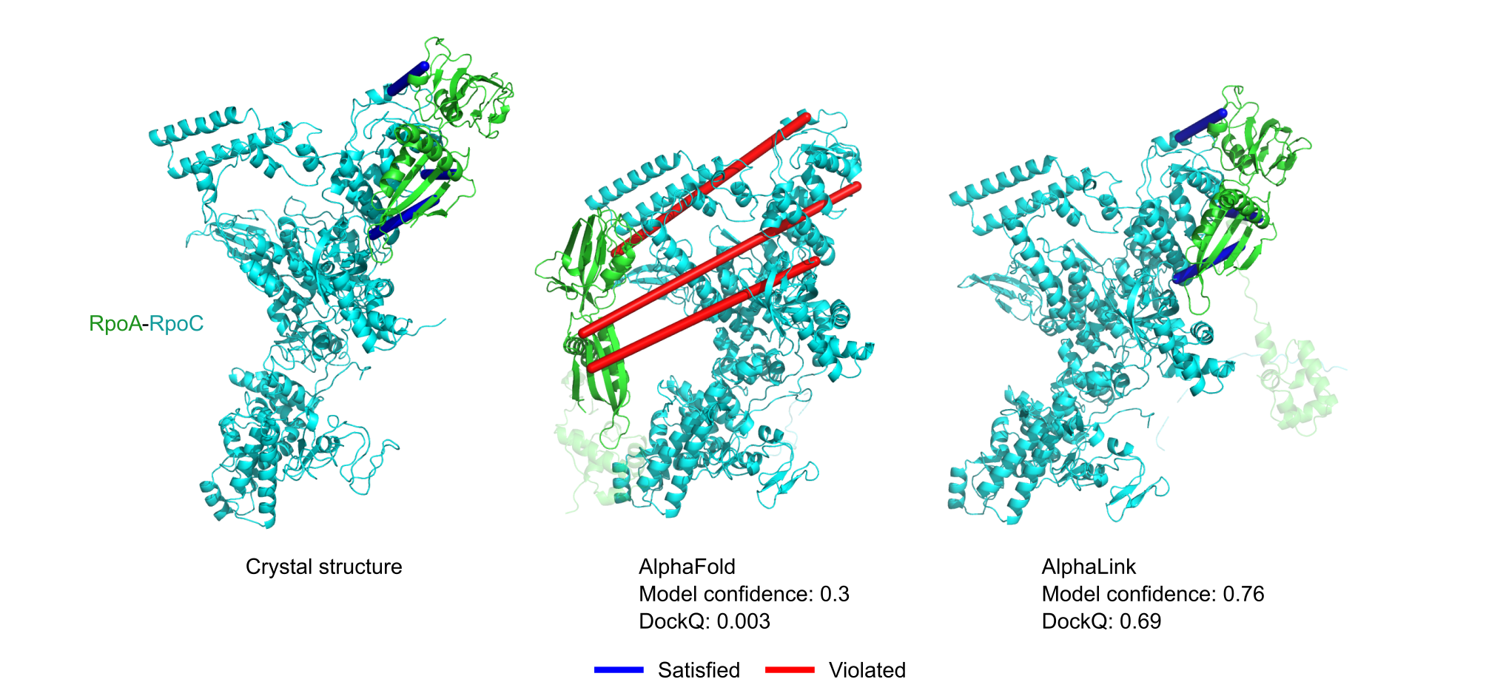
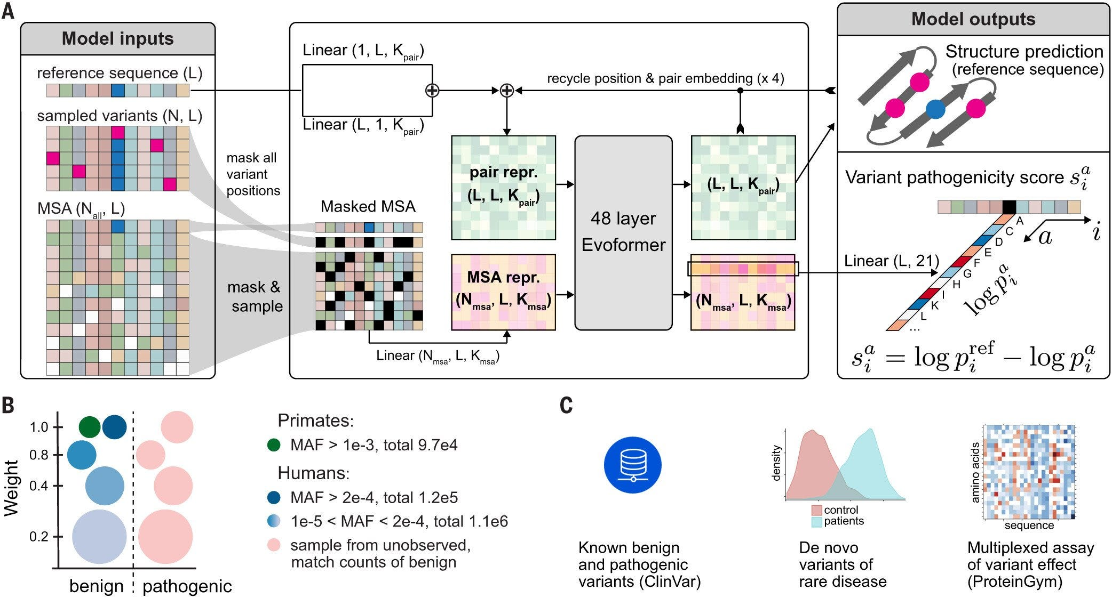
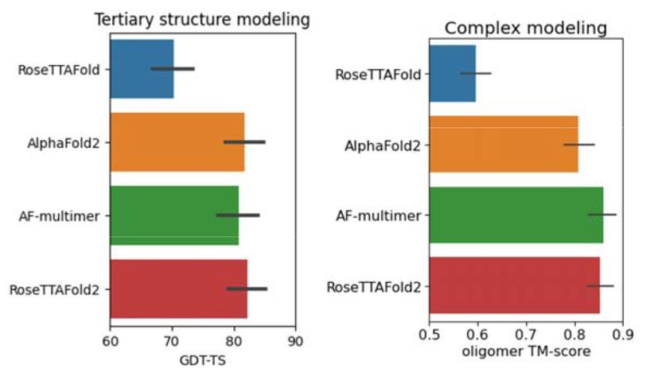
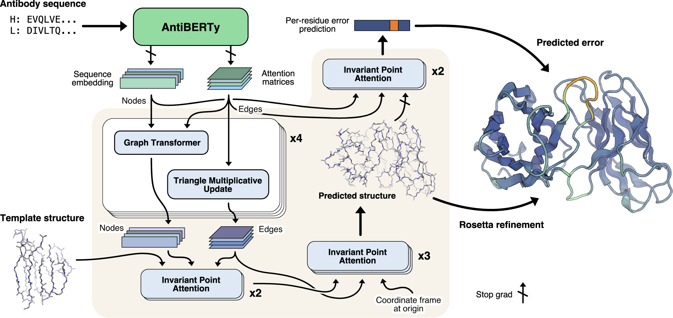
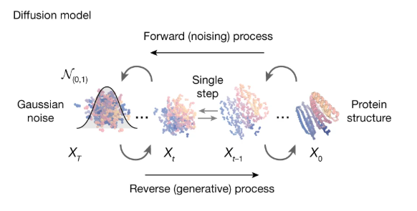

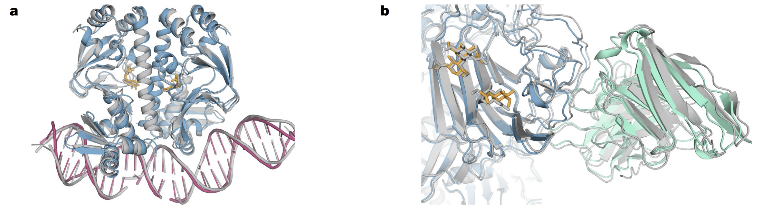
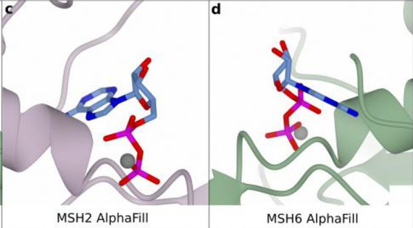
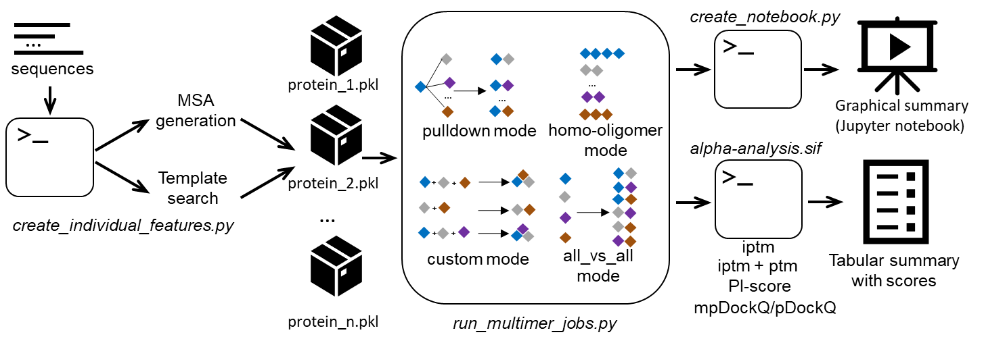
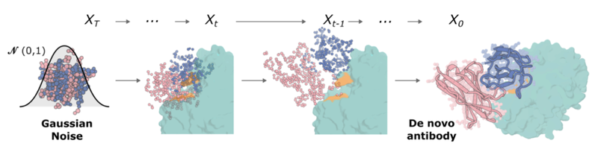

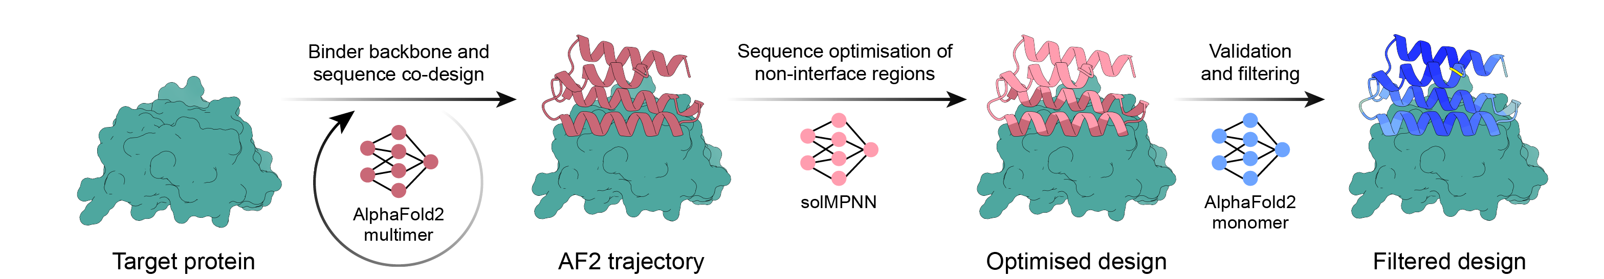
The quickly evolving world of protein structure prediction
David Baker
Demis Hassabis
John M. Jumper
CASP14
CASP15
CASP16
‘20
2021
2022
2023
2024
2025
AlphaFold2
AlphaFold2
release
ESMFold
OpenFold
AlphaFill
RFdiffusion
ESM3
Boltz-1
RosettaFold
+ release
OmegaFold
AlphaPulldown
IgFold
AlphaMissense
AlphaFold3
Boltzdesign1
ColabFold
ImmuneBuilder
RosettaFold-all-atom
HelixFold3
Boltz-1x
RosettaFold2
Chai-1
Rfantibody
AlphaLink2
BindCraft
AlphaFold3
code release

Slide 10
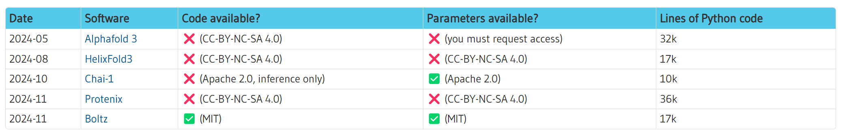
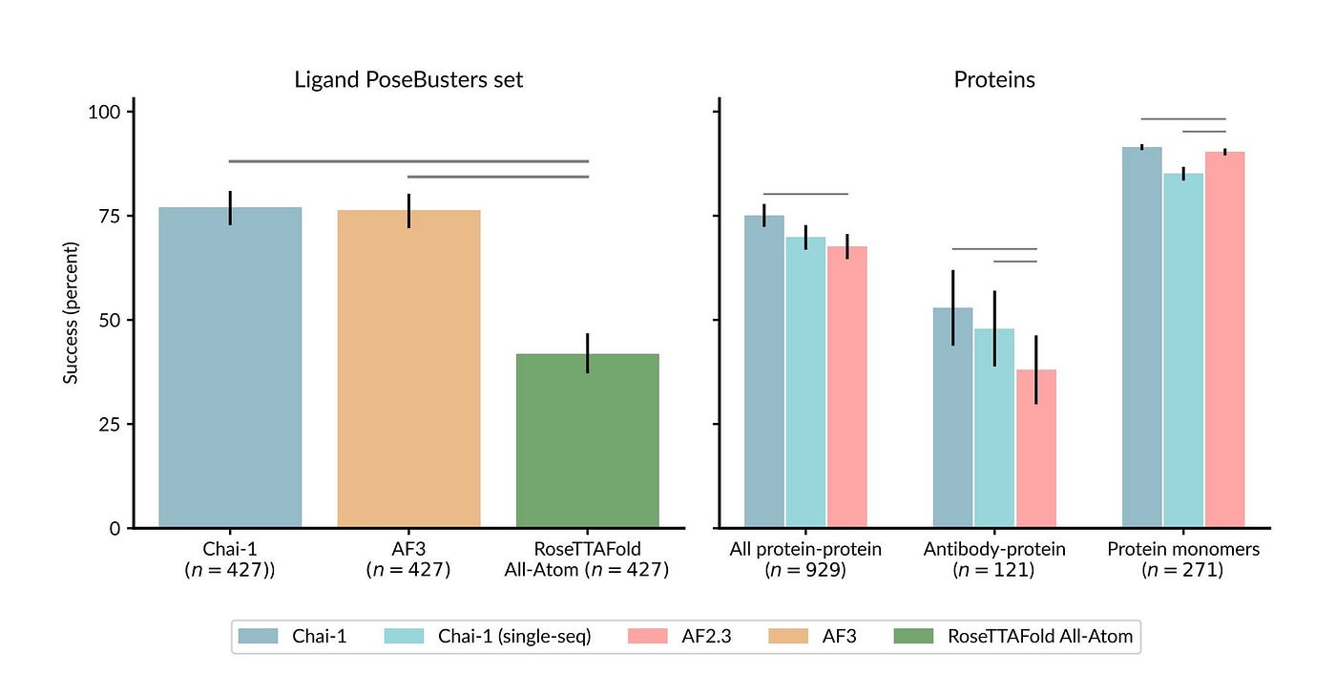
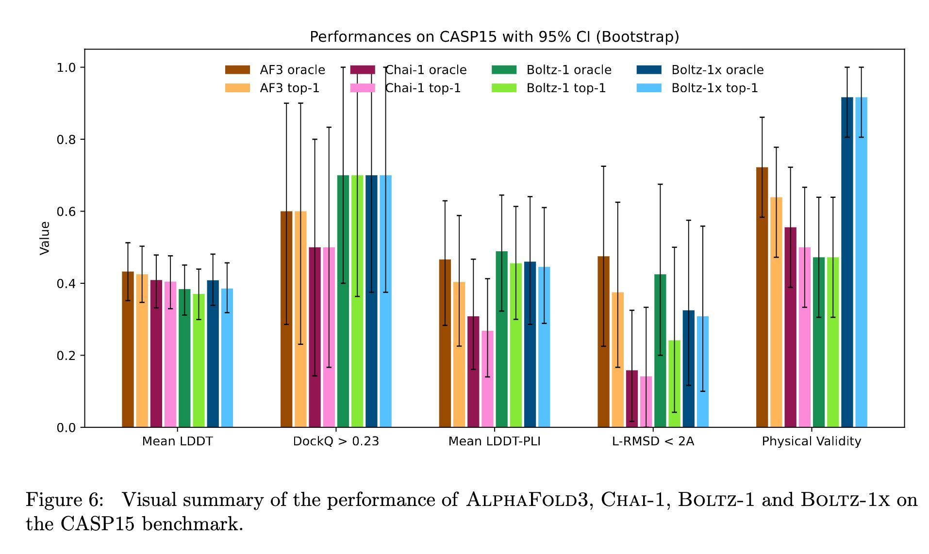
Different predictors, different licenses, similar performance
Nice write-up at https://blog.booleanbiotech.com/alphafold3-boltz-chai1

Slide 11
2. Basic AlphaFold principles

Slide 12
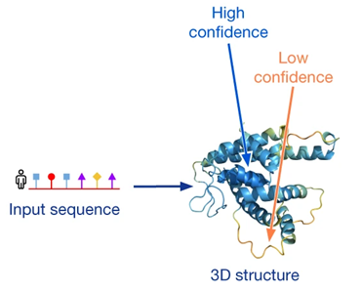
AlphaFold2 predicts 3-D structure for input sequences (monomers & complexes)
5x
(individual or complex)

Slide 13
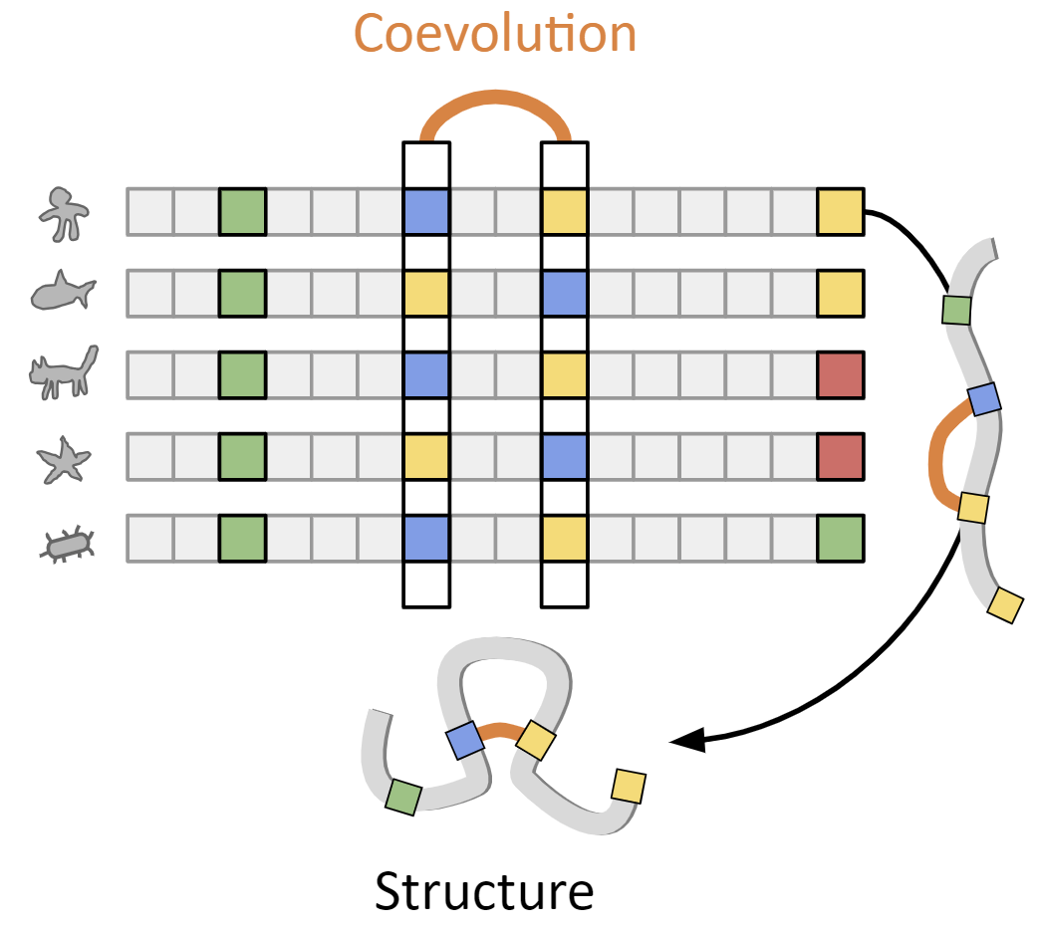
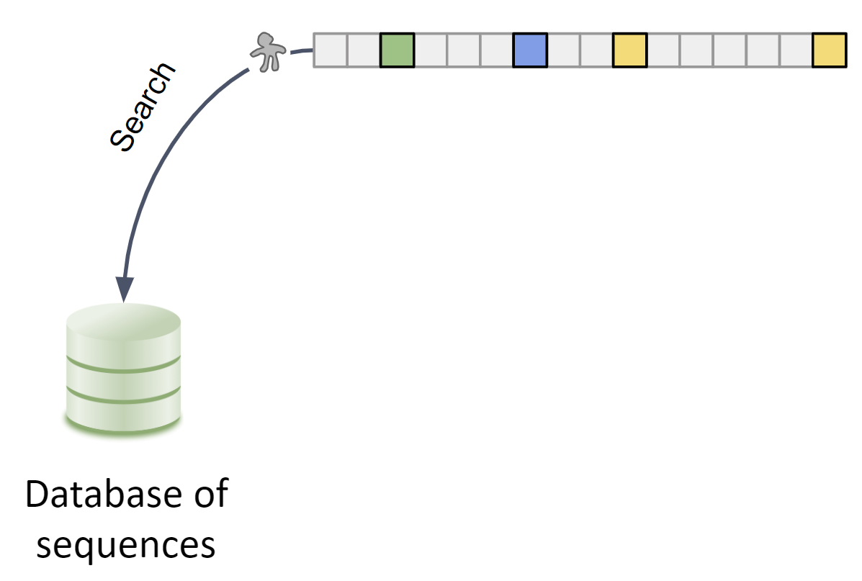
AlphaFold depends on coevolutionary information captured by MSAs (multiple sequence alignments)
Source: ColabFold presentation by Sergey Ovchinnikov

Slide 14
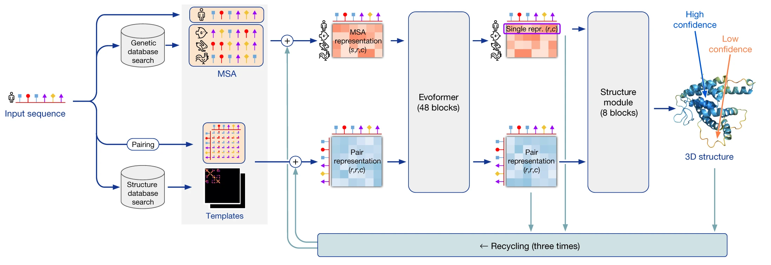
AlphaFold2 has multiple stages of prediction
Amber
relaxation
Run inputs through 5 trained AlphaFold models (GPU)
5 or 25 structures predicted
sorted on confidence
Relax all structures (Amber)
Multiple sequence alignment (CPU)
Structural templates search

Slide 15
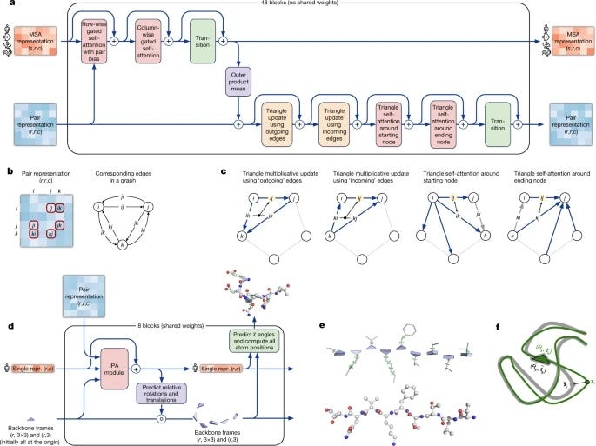
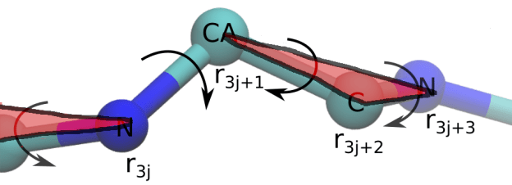
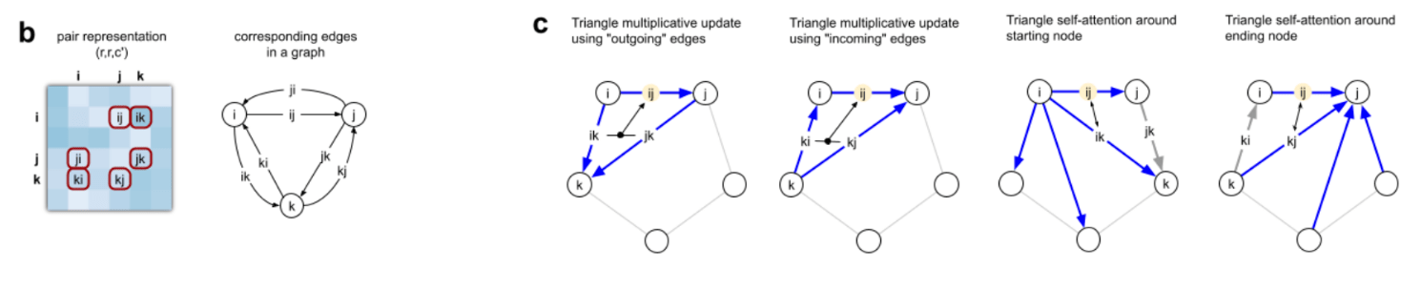
Evoformer Structure Module

Slide 16
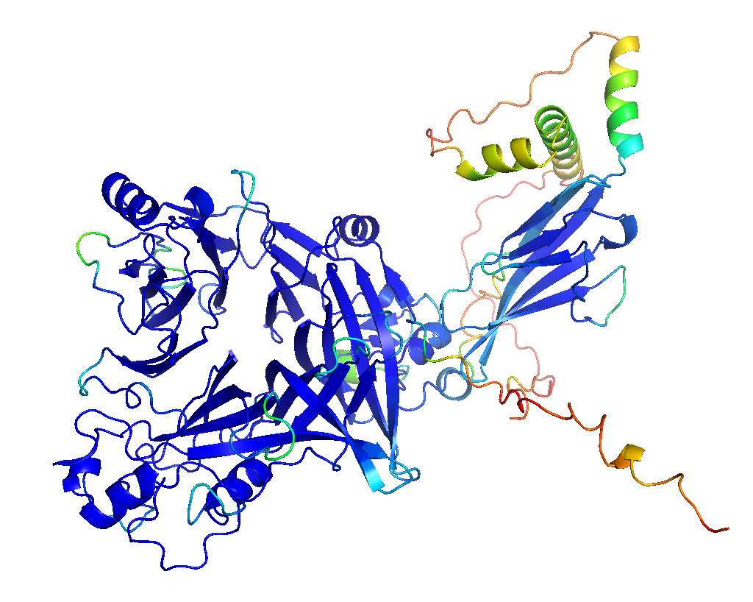
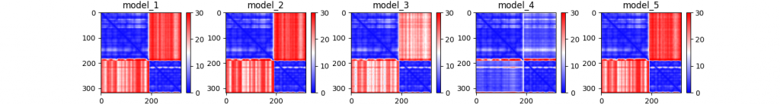
AlphaFold2 takes many training goals into account
Loss function contains
→ Frame Aligned Point Error ←
+ auxiliary losses
FAPE + torsion loss at intermediate structures
distogram prediction loss
Masked MSA prediction loss
“Experimentally resolved” prediction loss
Structural violation loss
…
Predicted template modelling score (TM) loss
Predicted local distance difference test (PLDDT) loss
Predicted aligned error (PAE) loss

Slide 17
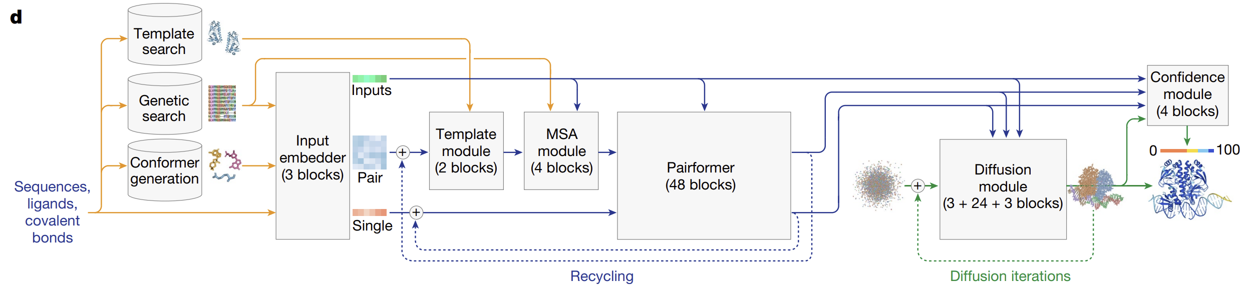
The AlphaFold3 pipeline introduces new modules
Input embedder to combine and refine information from different biomolecules
Diffusion module (<-> Structure module)

Slide 18
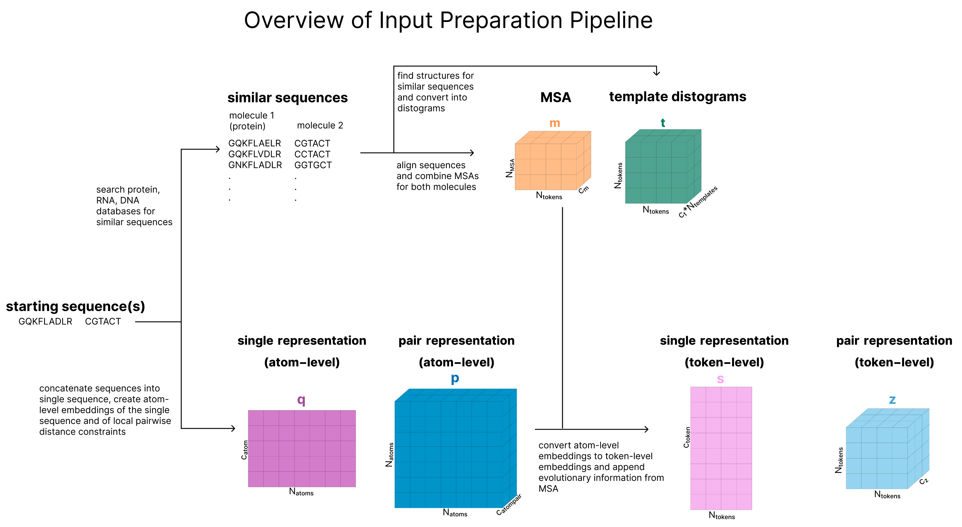
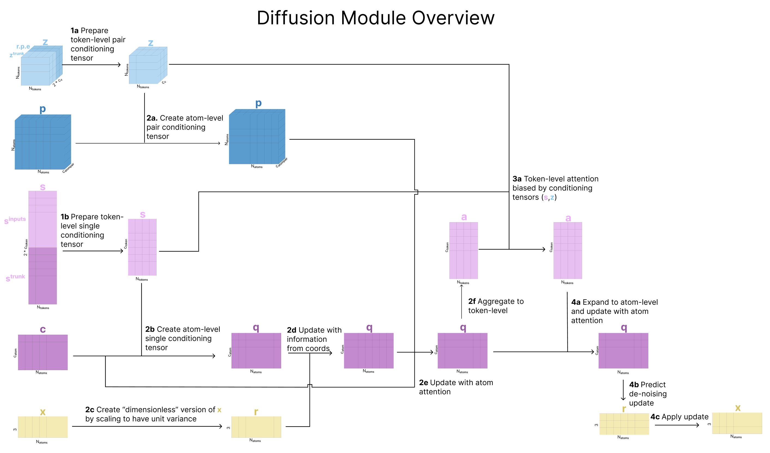
Input Embedder Diffusion Module

Slide 19
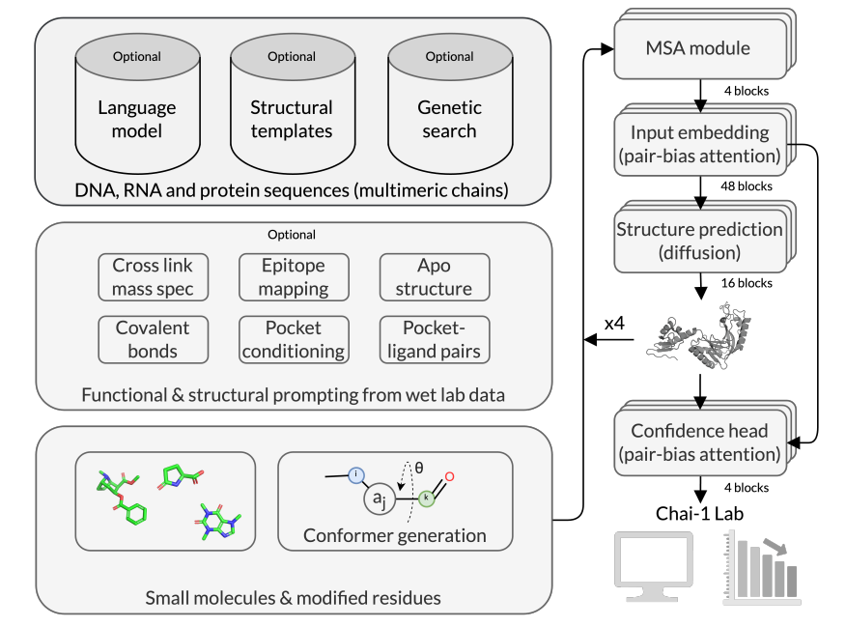
Chai-1 architecture

Slide 20
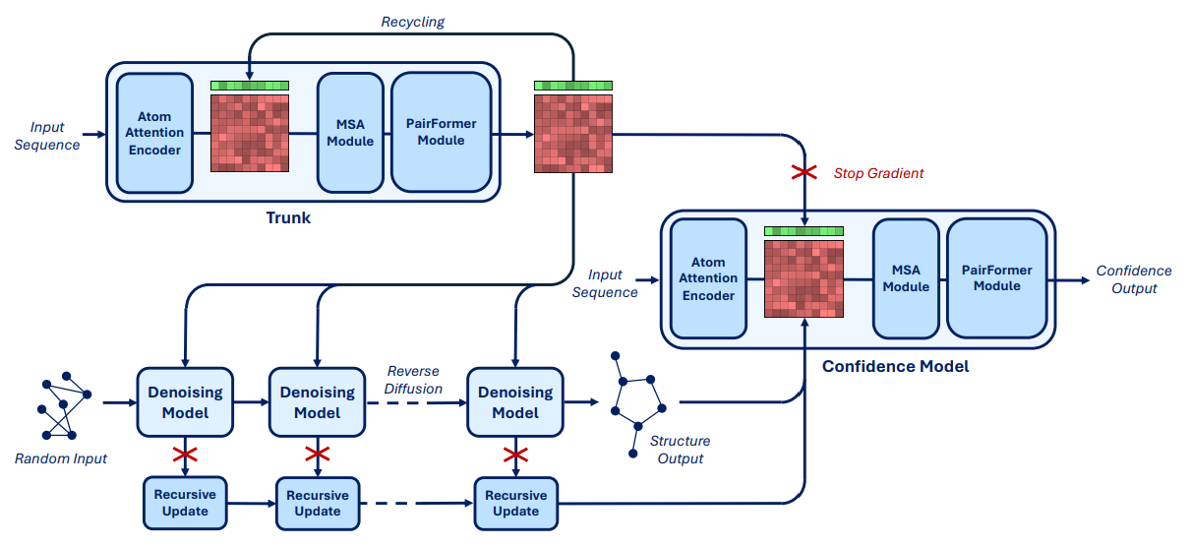
Boltz-1 architecture

Slide 21

3. Accessing protein (complex) predictions
Memory (RAM)
GPUs
Huge databases
(~2.2 TB)

Slide 22
AlphaFold2 is very resource-intensive software

Slide 23

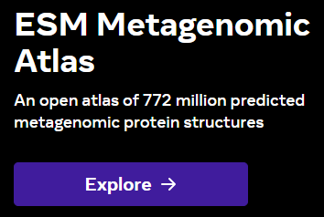


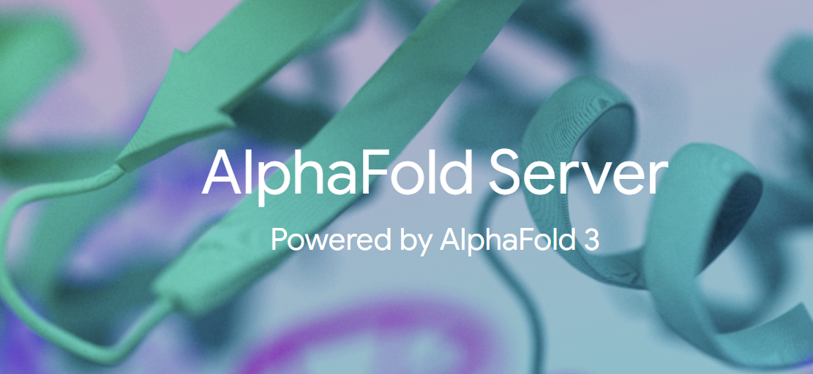



Protein co-folding predictors available via multiple sources
1.
2.
ColabFold
3.
4.

Slide 24
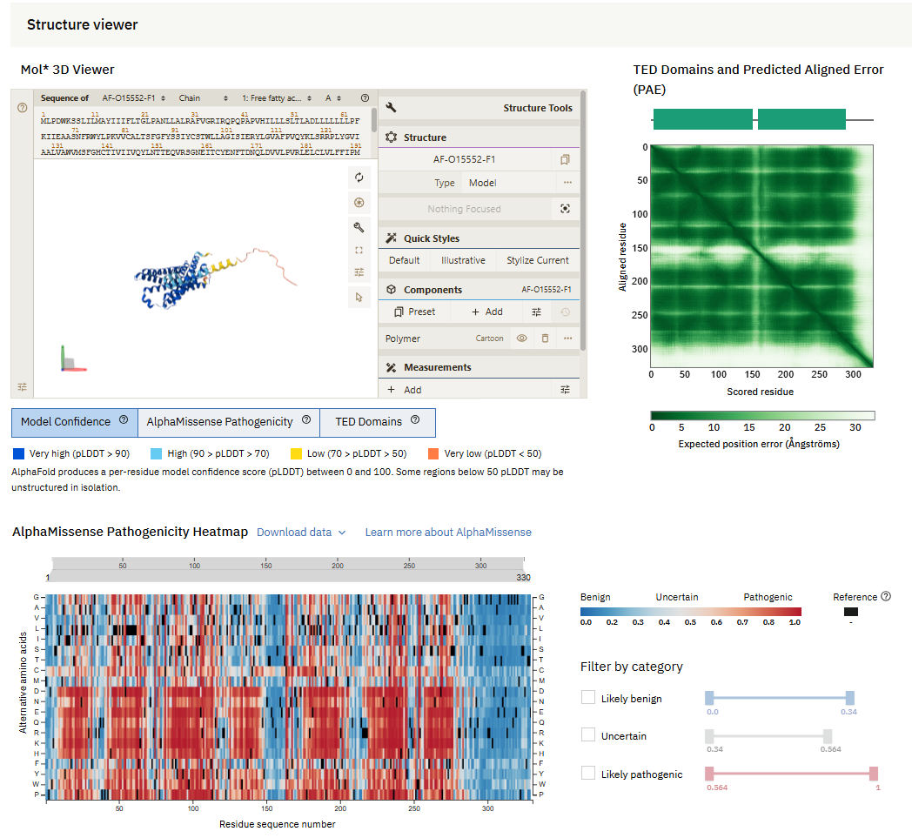
AlphaFoldDB
Predicted monomer structures
Coverage:
~ full UniProt
200 million proteins
from 1 million species
16 < length < 2700 (SwissProt)
16 < length < 1280 (rest of UniProt)
! No multimers !

Slide 25
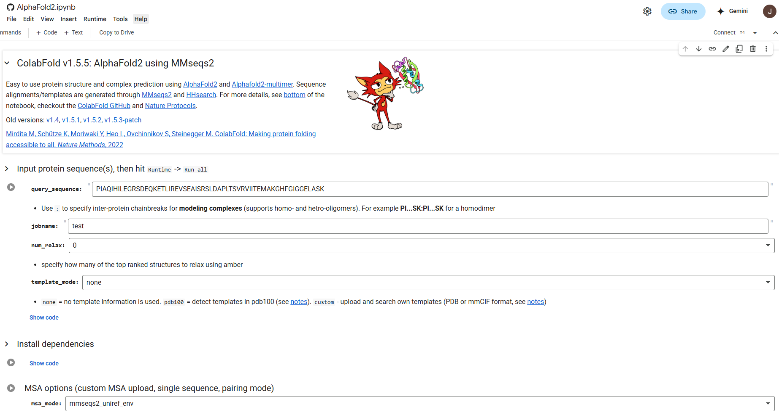
Google Colab
https://colab.research.google.com/github/sokrypton/ColabFold/blob/main/AlphaFold2.ipynb

Slide 26

High-Performance Computing (HPC)
Software and databases
installed
State-of-the-art GPU/CPU/RAM hardware
Expert support
Queuing system for allocating resources

Slide 27
AlphaFold on HPC
Advantages:
Set up a large batches of experiments
Faster + GPUs have greater memory → longer sequences
No hard availability restrictions (←→ Google Colab/servers)
Available GPU servers (UGent):
Available | joltik | 10 nodes | 4x V100 GPU per node (32GB) | 256 GiB RAM p/n | 800GB SSD p/n
Available | accelgor | 9 nodes | 4x A100 GPU per node (80GB) | ~500 GiB RAM p/n | 800GB SSD p/n
Available | litleo | 8 nodes | 2x H100 GPU per node (96GB) | ~315 GiB RAM p/n | 1.4TB SSD p/n
Tier 2

Slide 28
Computation time for different AlphaFold stages (on joltik)

Slide 29
Computation time for full runs on HPC-GPU, HPC-CPU and Google Colab (GPU)
Colab length limit

Slide 30


Prediction servers (AlphaFold3, Chai-1)

Slide 31
(Dis)advantages
Pre-computed data, huge collection of proteins
Only existing proteins
No multimeric assemblies
Lost most of its relevance with the advent of dedicated prediction servers
Very scalable
Dependant on available resources and installations
Very fast and convenient to use
No dedicated hardware needed
Limited number of predictions per day
Limited set of ligands / ions available
Proprietary data pushed into the cloud + IP?

Slide 32
4. AlphaFold on the HPC

Slide 33
Set-up: requirements
https://docs.vscentrum.be/en/latest/access/getting_access.html
Necessary: VSC account (account set-up should have been done in advance)
Logging in can be done via:
(a) Internet browser
(b) SSH client
Public/private key pair and SSH client needed
Command line introduction:
https://elearning.bits.vib.be/courses/alphafold/lessons/alphafold-on-the-hpc/topic/basic-unix-commands/

Slide 34







Set-up: logging in
login.hpc.ugent.be
transfer files
launch scripts

Slide 35
Set-up: directories and files
https://elearning.bits.vib.be/courses/alphafold/lessons/alphafold-on-the-hpc/topic/prepare-directories-and-files/
Default location when logging in
(~6GB)
Extra storage capacity
(~25GB)
When in a ‘virtual organization’
(~26TB shared)

Slide 36

Set-up: directories and files
In $DATA_VSC: create directory alphafold
There:
Create directory fastas
Create directory runs
Download alphafold_job_script.sh
OR copy contents to a file,
OR right-click on Raw > Save link as,
OR use wget with the raw link (Raw > Copy link) on the command line directly
OR use mkdir on the command line,
OR use New directory on the web interface

Slide 37

Set-up: directories and files
In fastas: create/upload your FASTA file
OR via command line (nano, vim, …)
OR by uploading an existing file to the web interface
OR by creating + editing a new file via the web interface

Slide 38

Set-up: modify alphafold_job_script.sh
https://elearning.bits.vib.be/courses/alphafold/lessons/alphafold-on-the-hpc/topic/setting-up-the-job-script/
download link

Slide 39




Set-up: submitting and monitoring
Necessary step: select the appropriate cluster (joltik in this case)
you can check it using ml
!! During these sessions only:
priority access to joltik via
qsub alphafold_job_script.sh --reservation=alphafold
After setting up the cluster and the files, submit your job!
- Only submit one job at a time (shared nodes)
Check status
To cancel runs: use qdel

Slide 40




Monitoring + outputs
error file: tells when something goes wrong
output file: tells where output files are located
Troubleshooting:
https://elearning.bits.vib.be/courses/alphafold/lessons/alphafold-on-the-hpc/topic/troubleshooting/

Slide 41
5. First exercise: submit a prediction on the HPC
https://elearning.vib.be/courses/alphafold/lessons/alphafold-on-the-hpc/
https://elearning.vib.be/courses/alphafold/lessons/alphafold-on-the-hpc/topic/basic-workflow-example-web-interface/

Slide 42
6. Evaluating & interpreting AlphaFold predictions

Slide 43

Metrics and scores to evaluate model accuracy
Local confidence
pLDDT (predicted local distance difference test)
Global confidence
PAE (predicted aligned error)
Individual scores:
Average PLDDT
PTM (predicted template modelling score)
iPTM (interface PTM)
…

Slide 44
pTM-score: intrinsic global accuracy estimate
TM-score indicates the similarity between two structures by a score between 0 and 1, where 1 indicates a perfect match between two structures
The TM-score is intended as a more accurate measure of the global similarity of full-length protein structures than the often used RMSD measure (independent of protein length, less sensitive to local dissimilarity).
pTM score is the predicted TM-score between the structural prediction and the (unknown) true structure
pTM for complexes == 0.2 * PTM + 0.8 * iPTM
Alphafold predictions are ranked based on the pTM score
References:
TM-score: Zhang Y and Skolnick J (2004). "Scoring function for automated assessment of protein structure template quality". Proteins
pTM score: Jumper et al., (2021). “Highly accurate protein structure prediction with AlphaFold”. Nature

Slide 45



pLDDT reflects local model accuracy
pLDDT: predicted local distance difference test
per residue confidence metric
Estimates agreement of local environment between true structure and prediction
structural models are coloured according to the pLDDT-metric (relative scale 1- 100):
Structural model for Human TSLP
4-helix bundle region
(high-confidence)
Signal sequence
Loop region
(low-confidence)
21
Notes:
How to asses to quality of the structural models?
predictions: predicted local distance difference test (pLDDT)
- pLDDT provides a per-residue condidence metric
- pLDDT provides an estimate for each residues on how well the local environment around each residue (mainchain + side chain conformations) matches the true (unknown) structure
- relative scale 1 – 100
- linear plot or colored-coded on structure (B-factor column in pdb file)
- low confidence regions are associated with disorder

Slide 46

PAE evaluates interdomain accuracy
P54725
Q5VSL9
https://www.deepmind.com/
Notes:
https://www.deepmind.com/publications/enabling-high-accuracy-protein-structure-prediction-at-the-proteome-scale

Slide 47
PAE-plot evaluates interdomain accuracy
Example:
https://alphafold.ebi.ac.uk/entry/Q13049
(see Predicted aligned error tutorial (scroll down))

Slide 48


Example: VHH72 + SARS-CoV-1 (PDB:6WAQ)
PTM=0.87
Green: PDB structure
Cyan: predicted by AlphaFold
Blue: SARS-CoV-1 RBD
Red: VHH72

Slide 49


Example: SARS-CoV-2 + VHH72
PTM=0.53

Slide 50


Example: SARS-CoV-2 + VHH E (PDB:7B14)
PTM=0.89

Slide 51


Interactive PAE plot online with PAE Viewer
http://www.subtiwiki.uni-goettingen.de/v4/paeViewerDemo
Christoph Elfmann, Jörg Stülke, PAE viewer: a webserver for the interactive visualization of the predicted aligned error for multimer structure predictions and crosslinks, Nucleic Acids Research, Volume 51, Issue W1, 5 July 2023, Pages W404–W410, https://doi.org/10.1093/nar/gkad350

Slide 52
Summarized: uncertainties and potential pitfalls
Low accuracy of regions where few sequences are available for alignment
Low accuracy of intrinsically unstructured regions
Limited information on structural dynamics / conformational states and protein stability (due to PDB mimicking)
Varying accuracy of multimeric assemblies (both FPs + FNs!)
Hit-or-miss on Ab/Nb complex predictions
Not suited for mutational impact estimation
Only prediction of proteins and protein complexes (no nucleic acids)
No information on co-factors/ligands/post-translational modifications

Slide 53
(Recap) Objectives for this class
Work together to cover a set of protein-protein interactions
Evaluate a set of interactors based on previous sessions
Include non-interactors as negative control to validate methodology
Distribute workload!
One individual report per student
1.5 to 2 pages (incl. figures/tables)
Brief description of the methodology
Small overview + interpretation of results (for the subset that the student worked on)

Slide 54

Improved customizability and user-friendliness with VIBFold
Extra options (MSA search, number of recycles, relaxation, …)
→ MMSeqs2 server call for the MSA is a significant speedup!
Automatic protein complex permutations (AB + BA)
Automatically generates visualizations and auxiliary files (PAE plots, jsons, …)
https://elearning.vib.be/courses/alphafold/lessons/vibfold-on-the-hpc/topic/instructions-inputs-and-outputs/

Slide 55
Links
https://github.com/jasperzuallaert/VIBFold
alphafold_job_script_multimer.sh
visualize_alphafold_results.py
submit_vibfold.py
submit_vibfold_interaction_candidates.py
VIBFold.py
VIBFold_adapted_functions.py
https://lab.chaidiscovery.com/
https://alphafoldserver.com/

Slide 56
Jasper Zuallaert
jasper.zuallaert@vib-ugent.be

